Slide 1
What is Spring MVC ?
Spring MVC is a popular module in Spring Framework and it is used to develop web application as well as RESTfull web services.
Spring MVC is called web framework because it provides all required components to develop a complete web application
The Spring MVC framework provides Model-View-Controller (MVC) architecture and ready components that can be used to develop flexible and loosely coupled web applications

Slide 2
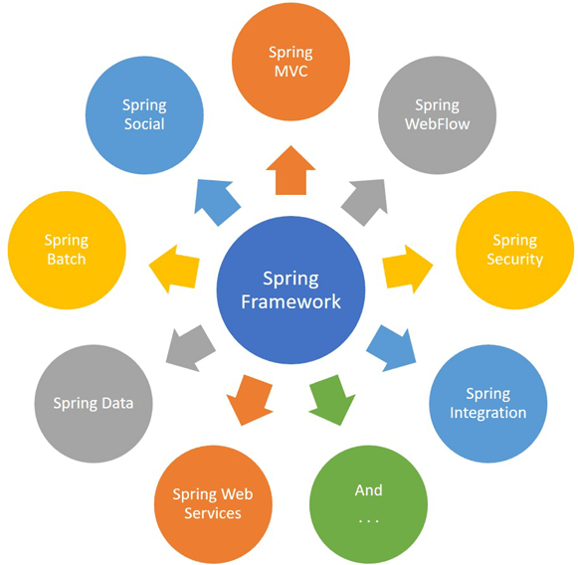

Slide 3
What is Spring MVC ?
The MVC pattern results in separating the different aspects of the application while providing a loose coupling between these elements.
The Model encapsulates the application data and in general they will consist of POJO(Plain Old Java Object).
The View is reponsible for rendering the model data and in general it generates HTML output that the client's browser can interpret.
The Controller is responsible for processing user requests and building an appropriate model and passes it to the view for rendering.

Slide 4
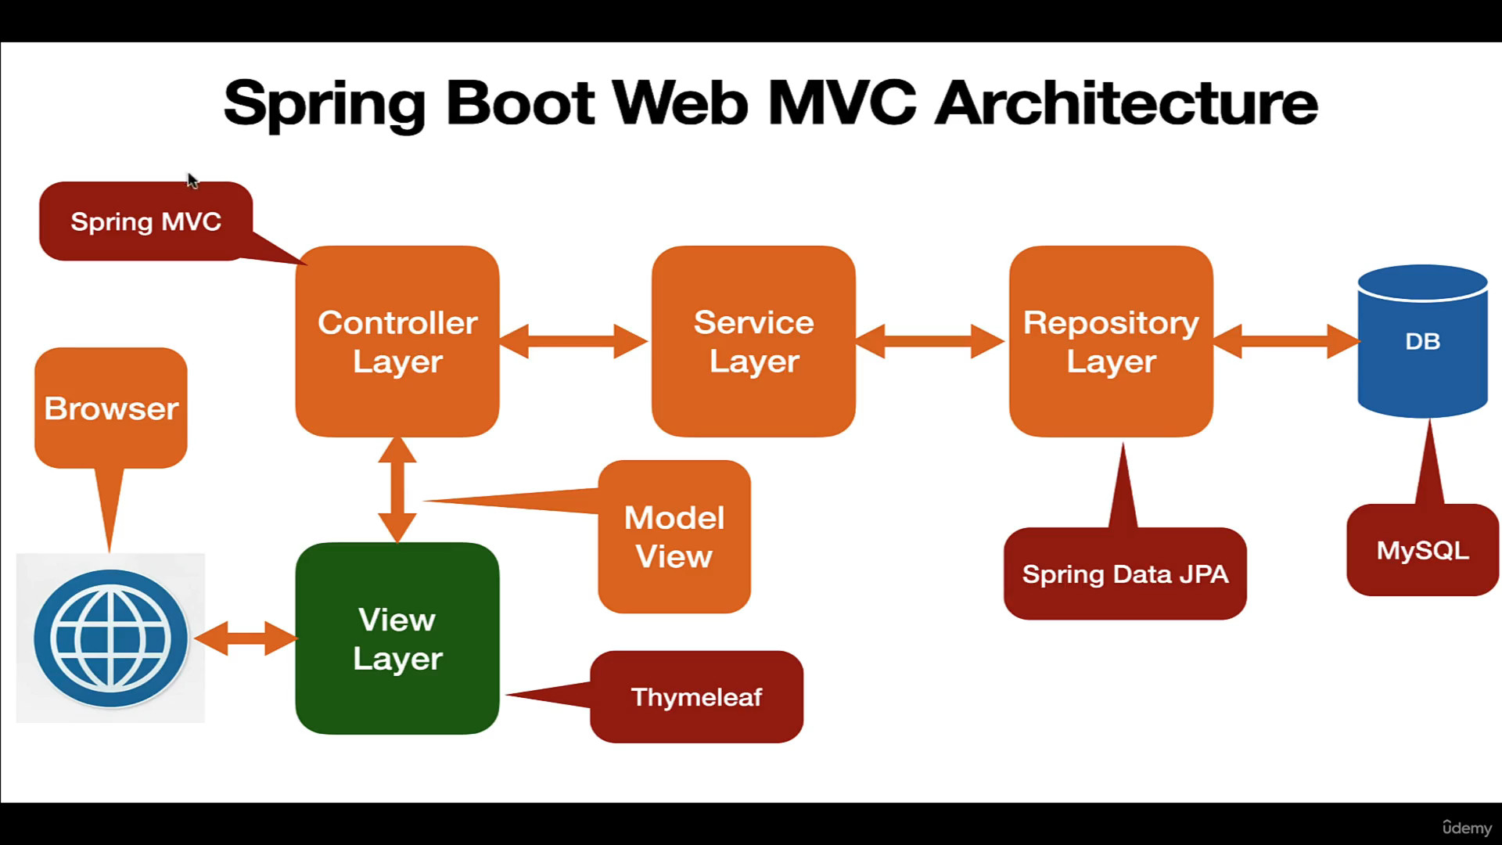

Slide 5
What is Spring MVC ?
The Spring MVC(model-view-controller) framework is designed arround a DispatcherServlet that handles all the HTTP requests and responses.
In Spring Web MVC, the DispatcherServlet class works as the front controller. It is responsible to manage the flow of the Spring MVC application.

Slide 6
What is DispatcherServlet ?
In Spring Web MVC, the DispatcherServlet class works as the front controller and it is responsible to manage the HTTP request flow of the Spring MVC application.
A Front Controller is common pattern in web application and it used to receive requests and delegate to other components in the application for actual processing. The DispatcherServlet is a front controller like it provides a single entry point for a client request to Spring MVC web application and forwards request to Spring MVC controllers for processing.

Slide 7
What is DispatcherServlet ?
DispatcherServlet is a actual Servlet and we can configure in web.xml or using AbstractAnnotationConfigDispatcherServletInitialzer.
Spring boot provides the spring-boot-start-web library for developing web applications using Spring MVC. One of the main features of Spring Boot is autoconfiguration. The Spring Boot autoconfiguration registers and configures the DispatcherServlet automatically. Therefore, we don’t need to register the DispatcherServlet manually.

Slide 8
Spring MVC Components
DispatcherServlet
Controller
Handler method
ViewResolver
View
Model

Slide 9
What is Controller ?
Controller in Spring MVC web application is a component that handles incoming HTTP requests.
Spring provides @Controller annotation to make a Java class as a Spring MVC Controller. The @Controller annotation indicates that a particular class server the role of a controller.
We will define handler method within Controller.

Slide 10
What is Handler Method ?
Handler method is a method annotated with @RequestMapping annotation (GetMapping and PostMapping) capable to handle incoming HTTP request.
We define Handler method in Controller.
Handler method process the HTTP request and return model and view.

Slide 11
What is ViewResolver ?
ViewResolver responsible to map logical view with actual view and return the actual view details back to the DispatcherServlet.
Spring boot auto configures ViewResolver for Thymeleaf so we don’t have to manually configure ViewResolver for Thymeleaf.

Slide 12
What is View ?
The View component merge view and model and forms a plain HTML output. Finally, the View component sends HTML output back to the DispatcherServlet.
DispatcherServlet send HTML output in response to display in a browser.

Slide 13
What is Model ?
The Model encapsulates the application data and in general they will consist of POJO (Plain old Java object).

Slide 14
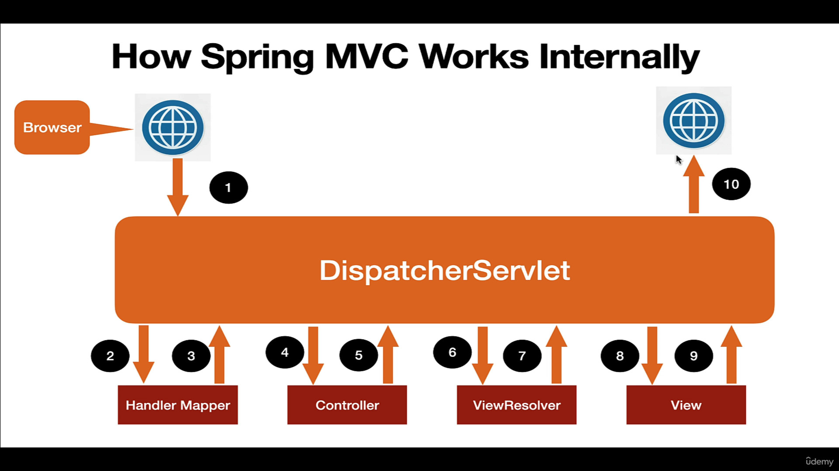

Slide 15
Step 1 – When the client (browser) sends an HTTP request to a specific URL. The DispatcherServlet of Spring MVC receives the request.
Step 2 – DispatcherServlet consult to HandlerMapper to identify which controller is responsible to handle the HTTP request.
Step 3 – HandlerMapper selects the controller which is mapped to the incoming request URL and returns the (selected Handler) and Controller details to DispatcherServlet.
Step 4 – Now DispatcherServlet knows which controller is responsible to process the request so DispatcherServlet will forward that request to corresponding controller to process the request.
Step 5 – Now the controller process the request, validates the request, and creates a model with data. Finally, the controller returns the logical name of view anh model to the DispatcherServlet.
Step 6 - DispatcherServlet consult ViewResolver to resolve a logical view with the physical view that exists in the application.
Step 7 – ViewResolver responsible to map logical view with actual view and return the actual view details back to the DispatcherServlet.
Step 8 – Now DispatcherServlet sends the view and model to the View component.
Step 9 – The View component merge view and model and forms a plain HTML output. Finally, the view component sends HTML output back to the DispatcherServlet.
Step 10 – The DispatcherServlet finally sends HTPL output as a response back to the browser for rendering.

Slide 16
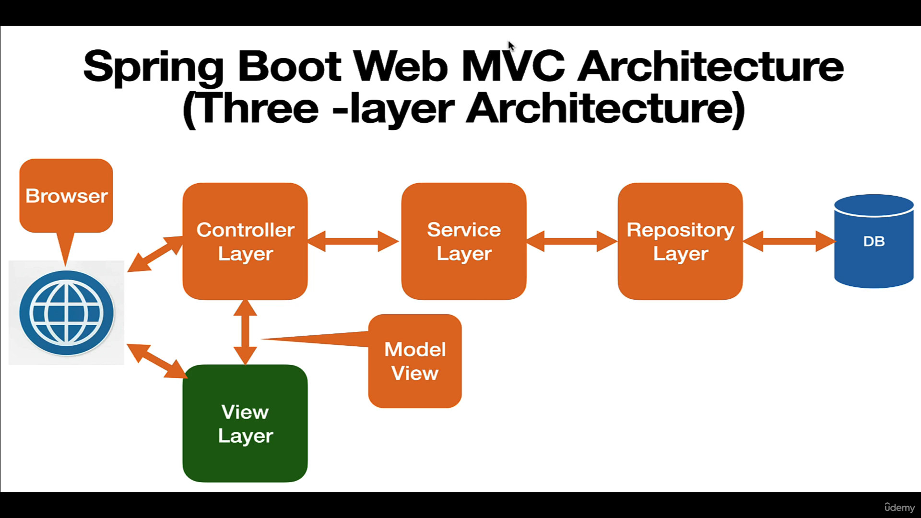

Slide 17
